Slide 1
DBMS Concept
Unit 1

Slide 2
1.1 DATABASE
A database is like a highly organized collection of information.
It is like a library houses books or a grocery store organizes different kinds of food.
these collections are stored electronically in computer systems and allow for efficient access, management, and analysis of the data.
Database handlers create a database in such a way that only one set of software program provides access of data to all the users.

Slide 3
1.1 Examples of databases used in various industries and applications
1. Online Banking:
Customer information, account balances, transaction history, payment details
2. E-commerce Websites:
Product catalog, inventory levels, customer orders, shipping information, payment data
3. Human Resources (HR) Systems:
Employee information, payroll data, benefits, performance reviews, training records

Slide 4
1.1 DATABASE
Structure:
Data in a database is typically organized in tables
Each table has rows and columns, where rows represent individual records and columns hold specific data points about those records.
Tables are related to each other through relationships. This allows for efficient and accurate retrieval of data across multiple tables.

Slide 5
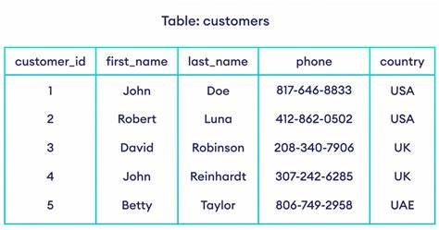
1.1 DATABASE

Slide 6
1.1 DATABASE
Types of data:
Databases can store different types of data, including numbers, text, dates, images, and even multimedia files.
Accessing and manipulating data:
We use special languages called query languages like SQL (Structured Query Language) to interact with databases. SQL allows us to retrieve, insert, update, and delete data in specific ways.

Slide 7
1.1 DATABASE
Uses of databases:
Databases are used in almost every aspect of modern life, from online shopping and social media to banking, healthcare, and government services.
Databases allow organizations to store large amounts of data, analyze trends, make informed decisions, and ultimately improve their services and operations.

Slide 8
1.1 DATABASE
Social media platforms (Twitter, Facebook, Instagram):
User profiles, posts, comments, and likes
Connections and relationships between users
Activity feeds and notifications
Healthcare systems (electronic health records, patient monitoring):
Patient medical records (demographics, medical history, medications, allergies)
Vital signs and sensor data (heart rate, blood pressure, oxygen levels)
Treatment plans and care

Slide 9
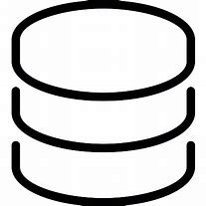
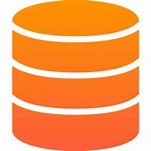
- SQL or Structured Query Language is used to operate on the data stored in a database. SQL depends on relational algebra and tuple relational calculus. - A cylindrical structure is used to display the image of a database.

Slide 10
Dbms
A Database Management System (DBMS) is a software system that is designed to manage and organize data in a structured manner.
It allows users to create, modify, and query a database, as well as manage the security and access controls for that database.
The DBMS manages the data and the database engine allows data to be accessed, locked, and modified by the database engine, and has a logical structure defined by the database schema.
The DBMS offers a centralized view of the data that may be accessed in a regulated manner by several users from numerous places, and provides concurrency, data security, integrity, and standard data management practices.

Slide 11
Two Content Layout with Table
First bullet point here
Second bullet point here
Third bullet point here
Class | Group A | Group B
Class 1 | 82 | 95
Class 2 | 76 | 88
Class 3 | 84 | 90

Slide 12
Add a Slide Title - 1

Slide 13
Add a Slide Title - 2

Slide 14
Add a Slide Title - 3

Slide 16
Add a Slide Title - 4

Slide 17
Add a Slide Title - 5

